Slide 1
Telemetry Order Set Education

Slide 2
Background
There are numerous issues surrounding telemetry within the facility but currently there are no “orders” within CPRS related to Telemetry except the “Admission (ADT)” order (ie Admit to Telemetry) and the generic “Call house officer” text orders. We have designed this order set to address these issues and minimize inappropriate telemetry use. We envision this will apply to all admitted patients on a monitor regardless of location. We have used the 2017 AHA Practice Standards and National VA telemetry guidebook as the basis for this order set.
Main features:
1) Indication-based ordering
2) Automatic discontinuation at 24-48 hours. ICU will default to 7 days.
3) Editable alarm orders that will allow more readily apparent telemetry setting customization. Defaults decided by DC VAMC’s alarm committee.

Slide 3
Telemetry order menu
Notes:
Each of these indications is clickable – launching the following associated orders

Slide 4
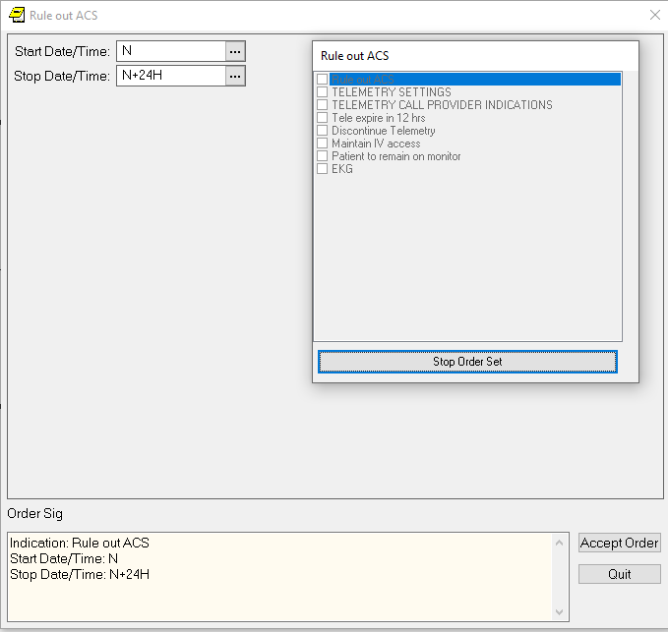
Includes orders for: -Automatic discontinuation (24hr from start/ordering time), as well as nursing text order 12hr prior to discontinuation prompting call to MD - Telemetry alarm settings - Call provider indications - EKG/IV access - Remain on monitor during transport order Ex: Chest pain, intermediate or high risk for ACS
Clicking an indication brings up associated orders

Slide 5
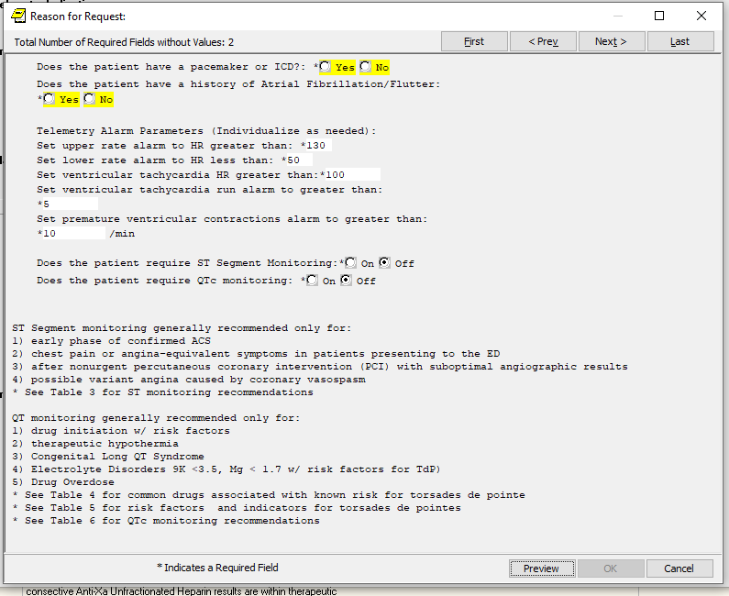
This creates a text order that can be edited as needed later
Telemetry Settings

Slide 6
Example of editing
Right click an order --> click “change” Edit the text as necessary

Slide 7
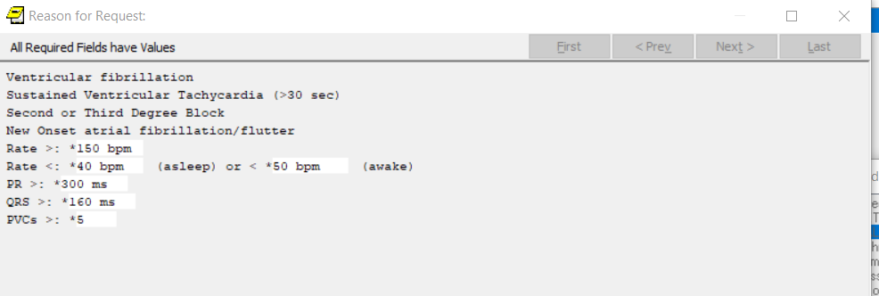
Telemetry call provider orders
Again, this can be edited as needed later

Slide 8
Telemetry Call Provider Orders

Slide 9
Automatic Discontinuation
Orders automatically end 24hr after being placed
12 hrs before expiration order pops up asking RN to call provider prior to ensure patients are continued or discontinued on telemetry appropriately

Slide 10
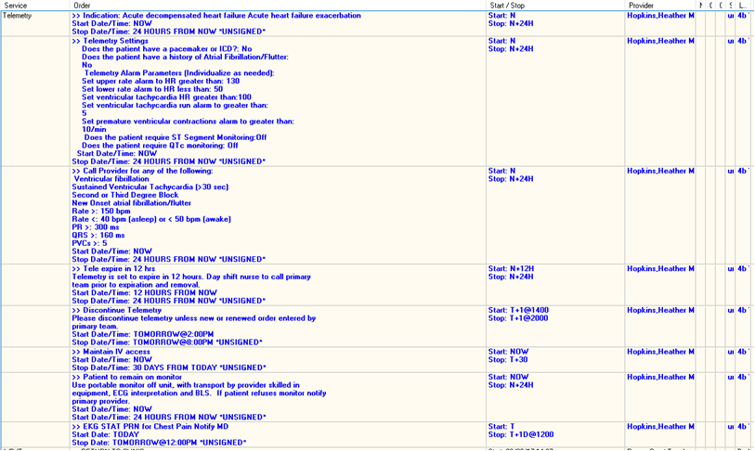
Notes:
An example of all the orders created. Note that the “Discontinue Telemetry” order will always start at 2pm the day after tele is ordered.

